Slide 1




CSS Styling Introduction
About the Course

Slide 2


Table of Contents
Course Objectives & Course Program
Examination
Learning Resources

Slide 3


CSS Styling: Objectives & Program
What Topics Shall We Cover?

Slide 4


CSS Styling – Course Topics
CSS Overview
CSS Presentation
CSS Layout
Preprocessors (for CSS)
Exam Preparation
CSS Exam

Slide 5
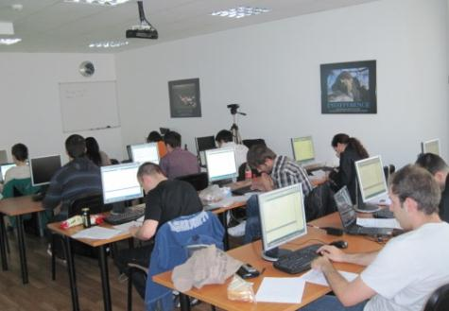


CSS Exam
Examination Criteria

Slide 6


CSS – Evaluation
Evaluation components
Practical exam – 75%
Homework – 10%
Homework evaluation – 5%
3 peer reviews per homework
Attendance – 10%
Bonuses
Forums activity – bonus up to 5%

Slide 7
Pass / Fail / Excellence Criteria
CSS Test – pass / fail / excellence criteria:
Test
Very low results → fail (course not taken)
Average results → pass (course taken)
High results → pass with excellence

Slide 8








Resources
What We Need in Addition to this Course Content?

Slide 9
Course Web Site & Forums
Register for the "Telerik Academy Forums":
Discuss the course exercises with your colleagues
Find solutions for the exercises
Share source code / discuss ideas
The CSS Styling official web site:
http://forums.academy.telerik.com/front-end-development/html-css
http://academy.telerik.com/student-courses/web-design-and-ui/css-styling

Slide 10
Required Software
A text editor, one of the following:
Microsoft Visual Studio 2013 or 2012 (Express will do the job)
Notepad++
Paint.NET
Sublime Text 2/3
MS WebMatrix
Aptana Studio
JetBrains WebStorm

Slide 11
CSS Styling
http://academy.telerik.com

